Slide 1
The Z-Transformation
Exercise-8.1
(Part-2)

Slide 2
Objective
Solving some more problems on Z-transformation
Methodologies:
Method of partial fraction will be used to determine inverse Z-transform

Slide 3


Problem(i): Use partial fraction expansion to find $x\left[n\right] for:$
$$X\left(z\right)=\frac{1}{\left.\left(1+0.5z^{−1}\right)\left(1−0.50z^{−1}\right)(1−z^{−1}\right)} , \left|z\right|>1$$
Solution: $X\left(z\right)=\frac{1}{\left.\left(1+0.5z^{−1}\right)\left(1−0.50z^{−1}\right)(1−z^{−1}\right)}$
$=\frac{1}{\left.\left(1+\frac{1}{2}z^{−1}\right)\left(1−\frac{1}{2}z^{−1}\right)(1−z^{−1}\right)}$
$$=\frac{\frac{1}{6} }{1+\frac{1}{2}z^{−1}}+\frac{−\frac{1}{2}}{1−\frac{1}{2}z^{−1}}+\frac{\frac{4}{3}}{1−z^{−1}}$$
$∴x\left[n\right]=\frac{1}{6}{\left(−\frac{1}{2}\right)}^{n}u\left[n\right]−\frac{1}{2}{\left(\frac{1}{2}\right)}^{n}u\left[n\right]+\frac{4}{3}u\left[n\right]$.
$$For z^{−1}=−2$$
$$A=\frac{1}{\left(1−\frac{1}{2}\left(−2\right)\right)\left(1+2\right)}$$
$$=\frac{1}{6}$$
$$For z^{−1}=2$$
$$B=\frac{1}{\left(1+\frac{1}{2}\left(2\right)\right)\left(1−2\right)}$$
$$=−\frac{1}{2}$$
$$For z^{−1}=1$$
$$C=\frac{1}{\left(1+\frac{1}{2}\left(1\right)\right)\left(1−\frac{1}{2}\left(1\right)\right)}$$
$$=\frac{4}{3}$$

Slide 4


Problem(ii): Use partial fraction expansion to find $x\left[n\right] for:$
$$X\left(z\right)=\frac{z^{−1}}{\left(1+0.75z^{−1}\right)(1−0.5z^{−1})} , \left|z\right|>1$$
Solution: $X\left(z\right)=\frac{z^{−1}}{\left(1+0.75z^{−1}\right)(1−0.5z^{−1})}$
$=\frac{z^{−1}}{\left(1+\frac{3}{4}z^{−1}\right)\left(1−\frac{1}{2}z^{−1}\right)}$
$$=\frac{−\frac{4}{5}}{1+\frac{3}{4}z^{−1}}+\frac{\frac{4}{5}}{1−\frac{1}{2}z^{−1}}$$
$∴x\left[n\right]=−\frac{4}{5}{\left(−\frac{3}{4}\right)}^{n}u\left[n\right]+\frac{4}{5}{\left(\frac{1}{2}\right)}^{n}u\left[n\right]$.
$$For z^{−1}=−\frac{4}{3}$$
$$A=\frac{−\frac{4}{3}}{\left(1−\frac{1}{2}\left(−\frac{4}{3}\right)\right)}$$
$$=−\frac{4}{5}$$
$$For z^{−1}=2$$
$$B=\frac{2}{\left(1+\frac{3}{4}\left(2\right)\right)}$$
$$=\frac{4}{5}$$

Slide 5


Problem(iii): Use partial fraction expansion to find $x\left[n\right] for:$
$$X\left(z\right)=\frac{1}{1−\frac{1}{4}z^{−2}}, \left|z\right|>\frac{1}{2}$$
Solution: $X\left(z\right)=\frac{1}{1−\frac{1}{4}z^{−2}}$
$=\frac{1}{\left(1+\frac{1}{2}z^{−1}\right)\left(1−\frac{1}{2}z^{−1}\right)}$
$$=\frac{\frac{1}{2}}{1+\frac{1}{2}z^{−1}}+\frac{\frac{1}{2}}{1−\frac{1}{2}z^{−1}}$$
$∴x\left[n\right]=\frac{1}{2}{\left(−\frac{1}{2}\right)}^{n}u\left[n\right]+\frac{1}{2}{\left(\frac{1}{2}\right)}^{n}u\left[n\right]$.
$$For z^{−1}=−2$$
$$A=\frac{1}{\left(1−\frac{1}{2}\left(−2\right)\right)}$$
$$=\frac{1}{2}$$
$$For z^{−1}=2$$
$$B=\frac{1}{\left(1+\frac{1}{2}\left(2\right)\right)}$$
$$=\frac{1}{2}$$

Slide 6


Problem(iv): Use partial fraction expansion to find $x\left[n\right] for:$
$$X\left(z\right)=\frac{1−\frac{1}{2}z^{−1}}{1+\frac{2}{5}z^{−1}−\frac{3}{5}z^{−2}} , \left|z\right|>\frac{1}{2}.$$
Solution: $X\left(z\right)=\frac{1−\frac{1}{2}z^{−1}}{1+\frac{2}{5}z^{−1}−\frac{3}{5}z^{−2}} =\frac{1−\frac{1}{2}z^{−1}}{\frac{1}{5}\left(5+2z^{−1}−3z^{−2}\right)}$
$$=\frac{1−\frac{1}{2}z^{−1}}{\frac{1}{5}\left(5+5z^{−1}−3z^{−1}−3z^{−2}\right)}$$
$$=\frac{1−\frac{1}{2}z^{−1}}{\frac{1}{5}\left\{5\left(1+z^{−1}\right)−3z^{−1}\left(1+z^{−1}\right)\right\}}$$
$=\frac{1−\frac{1}{2}z^{−1}}{\frac{1}{5}\left(1+z^{−1}\right)\left(5−3z^{−1}\right)}=$ $\frac{1−\frac{1}{2}z^{−1}}{\left(1+z^{−1}\right)\left(1−\frac{3}{5}z^{−1}\right)}$
$$=\frac{\frac{15}{16}}{1+z^{−1}}+\frac{\frac{1}{16}}{1−\frac{3}{5}z^{−1}}$$
$∴x\left[n\right]=\frac{15}{16}{\left(−1\right)}^{n}u\left[n\right]+\frac{1}{16}{\left(\frac{3}{5}\right)}^{n}u\left[n\right]$.
$$For z^{−1}=−1$$
$$A=\frac{1−\frac{1}{2}\left(−1\right)}{\left(1−\frac{3}{5}\left(−1\right)\right)}$$
$$=\frac{15}{16}$$
$$For z^{−1}=\frac{5}{3}$$
$$B=\frac{1−\frac{1}{2}\left(\frac{5}{3}\right)}{\left(1+\frac{5}{3}\right)}$$
$$=\frac{1}{16}$$

Slide 7


Problem(v): Use partial fraction expansion to find $x\left[n\right] for:$
$$X\left(z\right)=\frac{10z^{−2}}{\left(1+z^{−1}\right){\left(1−z^{−1}\right)}^{2}} , \left|z\right|>1.$$
Solution: $X\left(z\right)=\frac{10z^{−2}}{\left(1+z^{−1}\right){\left(1−z^{−1}\right)}^{2}}=\frac{\frac{10}{z^{2}}}{\left(1+\frac{1}{z}\right){\left(1−\frac{1}{z}\right)}^{2}}$
$$=\frac{\frac{10}{z^{2}}}{\left(\frac{z+1}{z}\right){\left(\frac{z−1}{z}\right)}^{2}}$$
$=\frac{\frac{10}{z^{2}}}{\frac{1}{z^{3}}\left(z+1\right){\left(z−1\right)}^{2}}$ $=\frac{10z}{\left(z+1\right){\left(z−1\right)}^{2}}$
$$∴\frac{X\left(z\right)}{z}=\frac{10}{\left(z+1\right){\left(z−1\right)}^{2}}$$
$$⇒\frac{X\left(z\right)}{z}=\frac{\frac{5}{2}}{z+1}+\frac{−\frac{5}{2}}{z−1}+\frac{5}{{\left(z−1\right)}^{2}}$$
$$⇒X\left(z\right)=\frac{5}{2}\frac{z}{z+1}−\frac{5}{2}\frac{z}{z−1}+5\frac{z}{{\left(z−1\right)}^{2}}$$
$∴x\left[n\right]=\frac{5}{2}{\left(−1\right)}^{n}u\left[n\right]−\frac{5}{2}u\left[n\right]+5n u\left[n\right]$.
Let $\frac{10}{\left(z+1\right){\left(z−1\right)}^{2}}=\frac{A}{z+1}+\frac{B}{z−1}+\frac{C}{{\left(z−1\right)}^{2}}$
$$⟹10=A{\left(z−1\right)}^{2}+B\left(z+1\right)\left(z−1\right)+C\left(z+1\right)$$
……………… eq. (1)
For $z=1$ equation (1) $⇒$
$$C=5$$
For $z=−1$equation (1) $⇒$
$$A=\frac{5}{2}$$
For $z=0$ equation (1) $⇒$
$$10=A−B+C$$
$$⇒B=A+C−10=\frac{5}{2}+5−10=−\frac{5}{2}$$

Slide 8

Exercises:
Use partial fraction expansion to find $x\left[n\right] for the following functions:$
$X\left(z\right)=\frac{2}{\left.\left(1+0.25z^{−1}\right)\left(1−0.50z^{−1}\right)(1+z^{−1}\right)} , \left|z\right|>1$
$X\left(z\right)=\frac{1+z^{−1}}{2−3z^{−1}−2z^{−2}} , \left|z\right|>2$
$X\left(z\right)=\frac{z^{−1}}{1−\frac{1}{9}z^{−2}}, \left|z\right|>\frac{1}{3}$
$X\left(z\right)=\frac{1−z^{−1}}{5+3z^{−1}−2z^{−2}} , \left|z\right|>1$
$X\left(z\right)=\frac{A}{\left(1−0.75z^{−1}\right)(1−0.25z^{−1})} , \left|z\right|>1$
$X\left(z\right)=\frac{z^{−1}}{\left(1+{0.75z}^{−1}\right){\left(1−0.75z^{−1}\right)}^{2}} , \left|z\right|>1$.

Slide 9
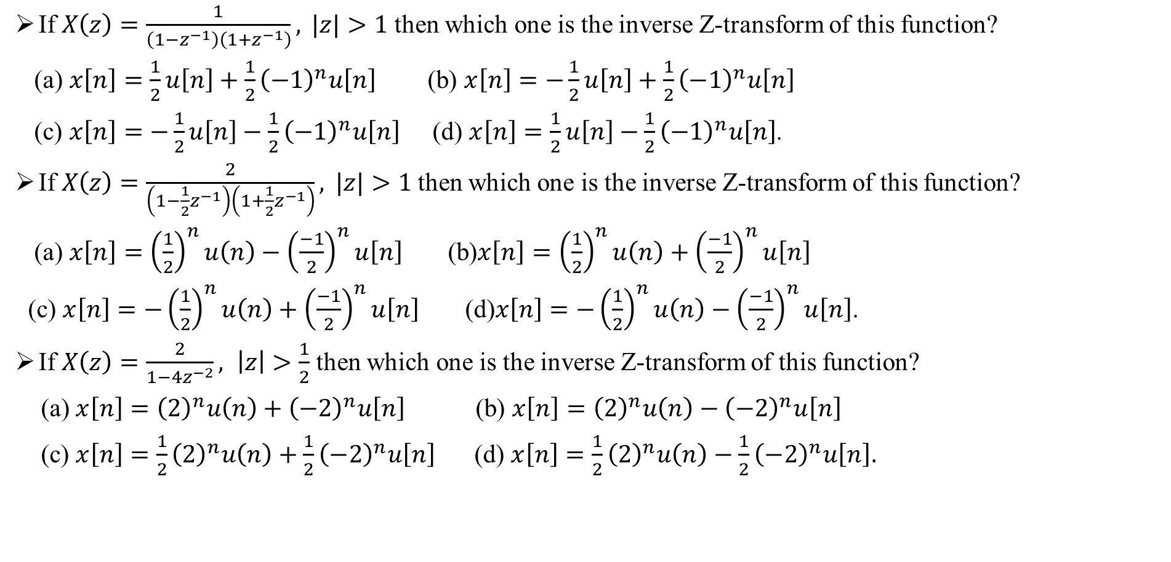
Sample MCQ:
If $X\left(z\right)=\frac{1}{\left(1−z^{−1}\right)\left(1+z^{−1}\right)}, |z|>1$ then which one is the inverse Z-transform of this function?
(a) $x\left[n\right]=\frac{1}{2}u\left[n\right]+\frac{1}{2}{\left(−1\right)}^{n}u\left[n\right]$ (b) $x\left[n\right]=−\frac{1}{2}u\left[n\right]+\frac{1}{2}{\left(−1\right)}^{n}u\left[n\right]$
(c) $x\left[n\right]=−\frac{1}{2}u\left[n\right]−\frac{1}{2}{\left(−1\right)}^{n}u\left[n\right]$ (d) $x\left[n\right]=\frac{1}{2}u\left[n\right]−\frac{1}{2}{\left(−1\right)}^{n}u\left[n\right]$.
If $X\left(z\right)=\frac{2}{\left(1−\frac{1}{2}z^{−1}\right)\left(1+\frac{1}{2}z^{−1}\right)}, |z|>1$then which one is the inverse Z-transform of this function?
(a) $x\left[n\right]={\left(\frac{1}{2}\right)}^{n}u\left(n\right)−{\left(\frac{−1}{2}\right)}^{n}u\left[n\right]$ (b)$x\left[n\right]={\left(\frac{1}{2}\right)}^{n}u\left(n\right)+{\left(\frac{−1}{2}\right)}^{n}u\left[n\right]$
(c) $x\left[n\right]=−{\left(\frac{1}{2}\right)}^{n}u\left(n\right)+{\left(\frac{−1}{2}\right)}^{n}u\left[n\right]$ (d)$x\left[n\right]=−{\left(\frac{1}{2}\right)}^{n}u\left(n\right)−{\left(\frac{−1}{2}\right)}^{n}u\left[n\right]$.
If $X\left(z\right)=\frac{2}{1−4z^{−2}}, \left|z\right|>\frac{1}{2}$ then which one is the inverse Z-transform of this function?
(a) $x\left[n\right]={\left(2\right)}^{n}u\left(n\right)+{\left(−2\right)}^{n}u\left[n\right]$ (b) $x\left[n\right]={\left(2\right)}^{n}u\left(n\right)−{\left(−2\right)}^{n}u\left[n\right]$
(c) $x\left[n\right]={\frac{1}{2}\left(2\right)}^{n}u\left(n\right)+{\frac{1}{2}\left(−2\right)}^{n}u\left[n\right]$ (d) $x\left[n\right]={\frac{1}{2}\left(2\right)}^{n}u\left(n\right)−{\frac{1}{2}\left(−2\right)}^{n}u\left[n\right].$

